Slide 1
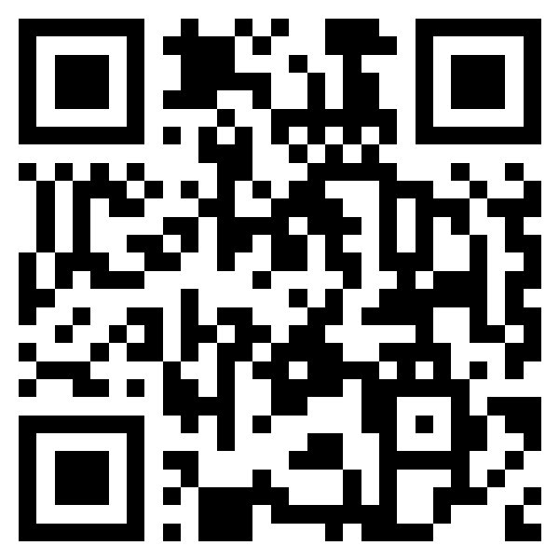
HSIMC FIELD · POLYU
COMP3424 · 5 OCT 2026
STOP 01 OF 10
1–2 MIN
FROM SENSORS
TO REALITY.
What changes when AI can see, understand, simulate and act?
Benny (Yan) Liao · Industry Engineer · Founder, HSIMC · Architecture & Strategy Advisor, InnoSpire
PolyU COMP3424 · Monday 5 October 2026 · AG206 · 14:15–15:00 (flexible)
10 stops · ~25–30 min core + discussion / demo
hsimc.tech/field/polyu
Notes:
[object Object],[object Object]

Slide 2
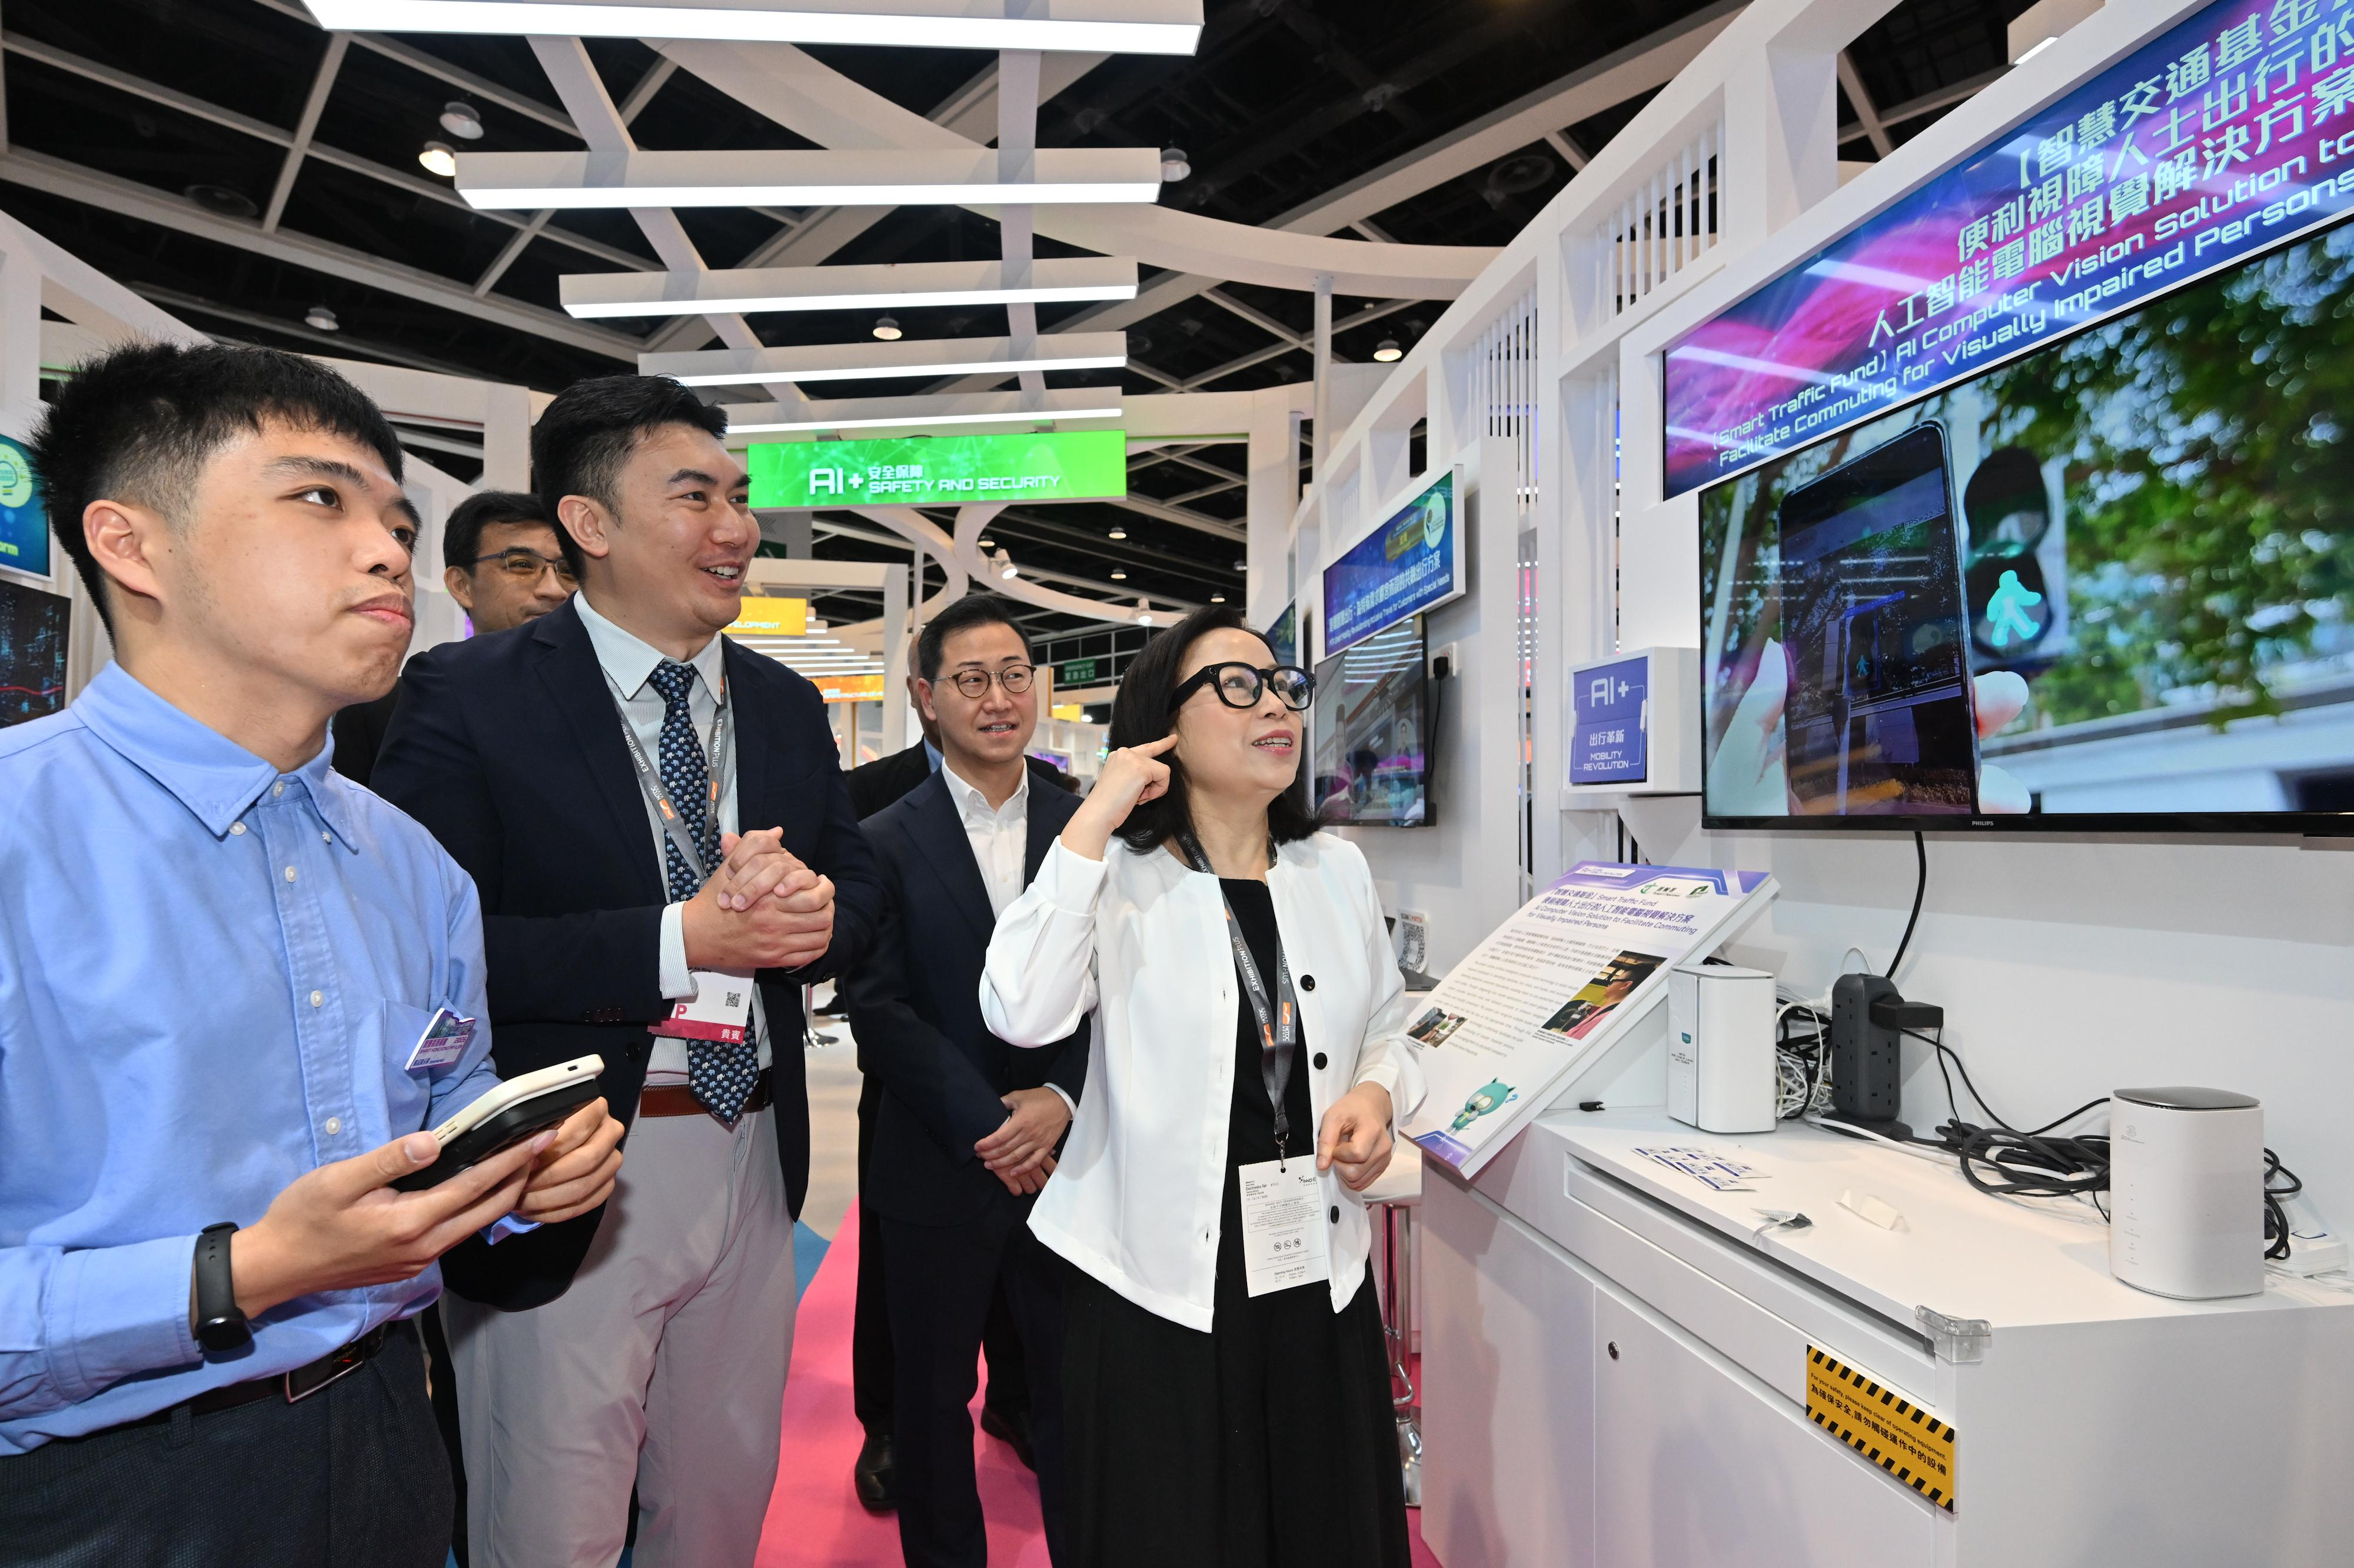
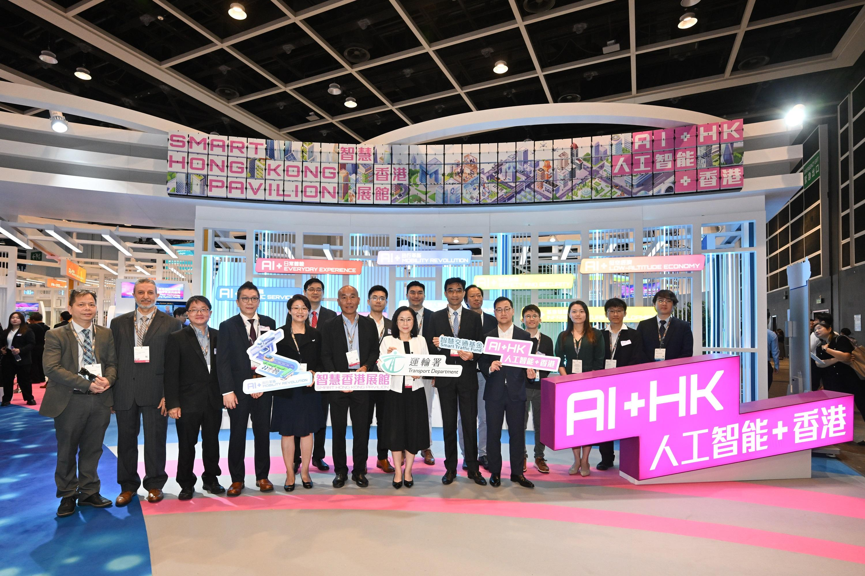
HSIMC FIELD · POLYU
COMP3424 · 5 OCT 2026
STOP 02 OF 10
2–3 MIN
External Industry Practitioner · Sharing & Technology Showcase
Four working contexts — one engineering thread
HSIMC
Founder · GenAI-native capability → physical Reality
InnoSpire
Architecture & Strategy Advisor · smart glasses / visual support
Pannex
Hong Kong public innovation context
Chief Digital Strategy Officer · product engineering / global delivery
HKSAR public records document Smart Traffic Fund projects at the Smart Hong Kong Pavilion, including AI computer-vision smart glasses for persons with visual impairment.
Kingsware 金智维
HK & Overseas Development Advisor · enterprise AI / digital employee
Public reference ≠ endorsement
The public setting shows where sensing becomes part of a human system — not government endorsement of HSIMC or this session.
HKSAR Government press release · 13 Apr 2026
Notes:
[object Object],[object Object]

Slide 3
HSIMC FIELD · POLYU
COMP3424 · 5 OCT 2026
STOP 03 OF 10
2–3 MIN
The sensor is no longer the endpoint.
Where does the sensor end?
SENSE
01
A physical signal can now become context for machine understanding — and possibly action.
02
UNDERSTAND
03
SIMULATE
04
DECIDE
Not every system needs all six.
But once observation crosses into action, authority and evidence matter.
05
ACT
06
EVIDENCE
Notes:
[object Object],[object Object]

Slide 4
HSIMC FIELD · POLYU
COMP3424 · 5 OCT 2026
STOP 04 OF 10
2–3 MIN
1989 → 2026: the tools changed. The engineering question stayed.
1989
1997
2015
2016
2017
2026
Applied Physics
Standards
Machine Vision
IoT + Robotics
Connected Value
GenAI + Reality
Measurement · physical signals
Repeatability · interoperability
Industry 4.0 · CPS
Connected sensing
NB-IoT · blockchain
Agents · authority · evidence
How do we know what is happening in Reality — and what can safely happen next?
Keep the engineering question underneath the fashionable word of the year.
Notes:
[object Object],[object Object]

Slide 5
HSIMC FIELD · POLYU
COMP3424 · 5 OCT 2026
STOP 05 OF 10
3 MIN
Digital twins after GenAI
A twin can become operational context for an agent.
DIGITAL TWIN
SIMULATION
What is happening?
Relevant state, relationships and constraints.
What might happen?
Explore possible outcomes before changing Reality.
AI / AGENT
PHYSICAL REALITY
What should happen next?
Reason over context; propose bounded next actions.
Can it actually happen?
Capability · access · power · calibration · identity · authority · evidence.
A good answer is not yet an action. A possible action is not yet an authorized action.
Notes:
[object Object],[object Object]

Slide 6
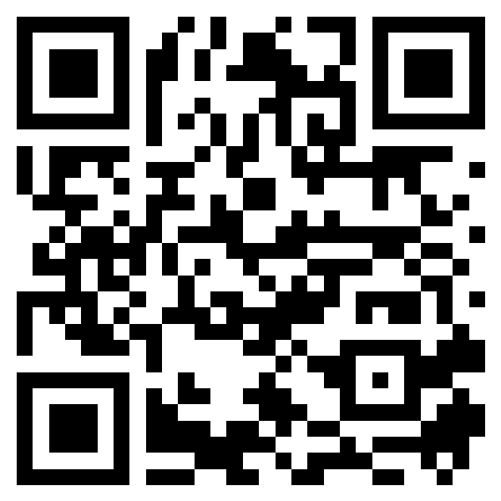
HSIMC FIELD · POLYU
COMP3424 · 5 OCT 2026
STOP 06 OF 10
3 MIN
Give students Reality, not only exercises.
SUMMER INTERN TEAM 2026
5 students · 53 links
Pick one student. Ask: what capability did this person make possible?
Idea → code / CAD → physical or digital result → live runtime → user → evidence → continuation
SOFTWARE / AI
PAYMENT
The goal was not “finish a tutorial.”
The goal was to discover where an idea fails when it meets Reality.
IoT / VISION
CAD / 3D PRINT
Browse later
LIVE RUNTIME
nicholas90.homelinked.tech/team/
EVIDENCE
Notes:
[object Object],[object Object],[object Object]

Slide 7
HSIMC FIELD · POLYU
COMP3424 · 5 OCT 2026
STOP 07 OF 10
2–3 MIN
MCP & callable capability
NAMING IS NOT CAPABILITY.
ADDRESS
≠
CAPABILITY
≠
AUTHORITY
A domain can declare where a capability should live. Engineering begins when what is behind the address is real, callable, bounded, authorized and observable.
mcp.makehere.tech
MCP-ready namespace example · current status matters
Namespace → endpoint → tool → permission → bounded execution → evidence
Notes:
[object Object],[object Object]

Slide 8
HSIMC FIELD · POLYU
COMP3424 · 5 OCT 2026
STOP 08 OF 10
3 MIN
Before graduation
9 months is enough to build evidence.
Do not try to master every new framework. Make one real capability work end-to-end.
01
Can you sense or capture a real condition?
02
Can you explain what the data means — and what it does not mean?
03
Can AI or software use the context safely?
04
Can another system call or continue your work?
05
Can you show evidence that the result actually happened?
Notes:
[object Object],[object Object],[object Object]

Slide 9
HSIMC FIELD · POLYU
COMP3424 · 5 OCT 2026
STOP 09 OF 10
1–2 MIN
Use what is useful. Ignore what is not.
HSIMC
PUBLICATIONS
INTERN TEAM
Distributed GenAI-native capability production infrastructure
Longer reading on infrastructure, practice and participation
Five student spaces from the 2026 summer work
hsimc.tech/
hsimc.tech/publications/
nicholas90.homelinked.tech/team/
One page → all links → continue later
Notes:
[object Object],[object Object]

Slide 10
HSIMC FIELD · POLYU
COMP3424 · 5 OCT 2026
STOP 10 OF 10
1–2 MIN
Closing thought
REALITY CAN →
I CAN ACT.
Your value in the AI era is not only what you know.
It is what you can make possible in Reality.
A capability is real only when the physical world contains the access, authority and evidence needed for action.
Questions / challenges?
Notes:
[object Object],[object Object],[object Object]

